Slide 1
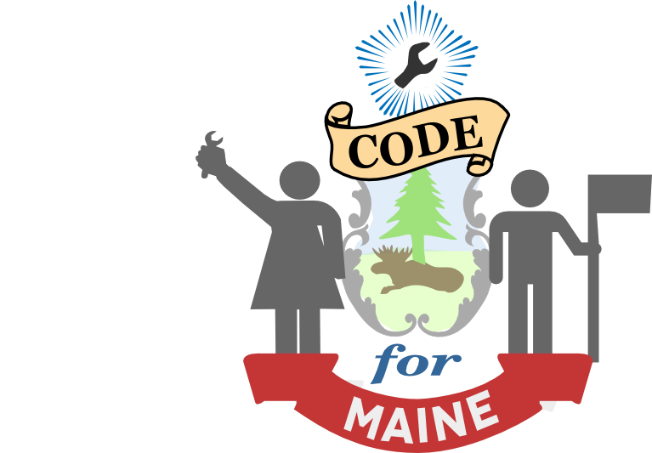


Powered By

Slide 2
.
The Fellowship, CfAs flagship program, connects talented developers and designers with local governments to harness technology for public good.
The Brigade is an organizing force for civic minded developers, designers, data scientists, and leaders who contribute their talents towards addressing the problems we see everyday.
The Accelerator: With more than $140 billion poured into the civic tech industry — we’re looking to find and support entrepreneurs to take advantage of it, and disrupt the current ways of doing business.
The Peer Network: The Peer Network connects local governments around the country to facilitate peer learning, collaborative problem-solving, and the spread of innovation best practices between cities.

Slide 3
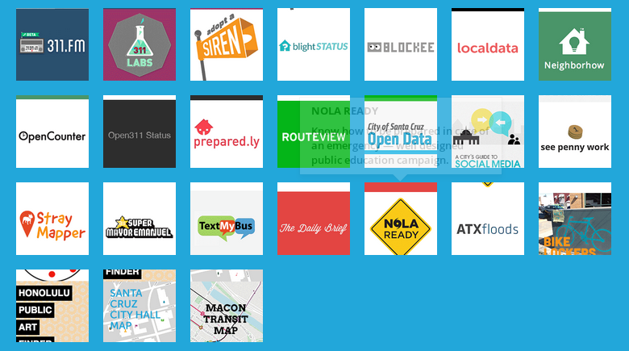
2012 CfA Fellowship Apps

Slide 4
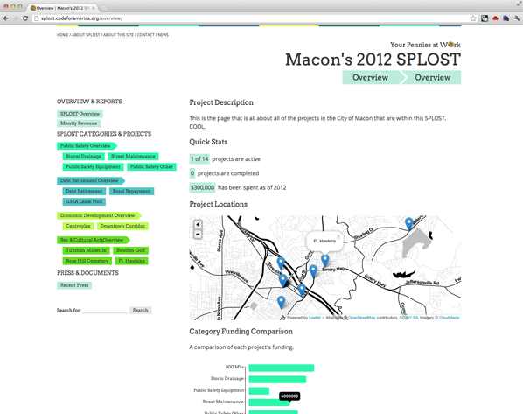
a transparency toolkit
see penny work
budget and project visualization
See Penny Work was built with municipal tax referendums in mind. A Wordpress theme + Google Spreadsheet powered visualization kit to make information about your projects and budget clear and accessible through charts, maps, tables, photos, blog posts...
See Penny Work is a Wordpress theme that's connected to Google spreadsheets. The theme is customized by you so that the style and projects on the sidebar fit with your budget and tastes. Each page gets its information from the input of the creator (like project descriptions and photos), the spreadsheets (like the maps, charts and tables) or through querying tagged items (like documents and related posts). More details on this futher on.

Slide 5
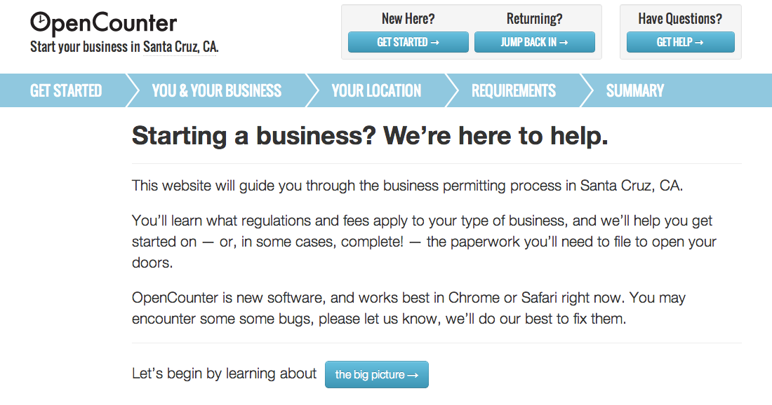


Slide 6






an online marketplace for community projects that allows you to share ideas for making the city better, and to turn those ideas into projects that have real impact.
Bringing together the interactivity of social networks and the incentives of online games, Community PlanIt transforms participatory planning into a fun, engaging activity for all ages.
share your ideas and insights for your city, support your neighbors’ ideas, and connect with people who share your interests.
Open Town Hall
A Web-Based Collaboration and Decision-Making Tool
Online forums made civil, legal and insightful

Slide 7
Code for Maine
The purpose of Code for Maine is to create and sustain local instances of goals and strategic outcomes shared by the national network:
Governments leveraging technology more effectively
Citizens and community groups solving civic issues
Municipalities/Regions collaborating to work better
Civic apps built on linked, open data
Encouraging local innovation

Slide 8
Code for Maine 2012-2013 Goals
A Lasting Local Presence
  Well-documented activities via Web for others to build on if necessary
  Partnerships with Anchor Institutions
  Volunteer CfA Brigade akin to Volunteer Fire Department
Introduce State, and Municipal Governments to Civic Technology Through Working Models
Introduce National/Global Networks to Working Models of Small Cities and Rural Regions Deploying Civic Technology

Slide 9
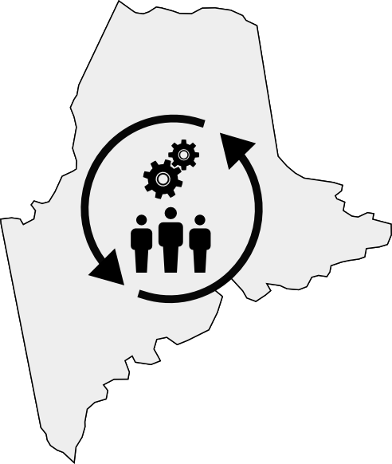
Capacity Building Through Community Building

Slide 10
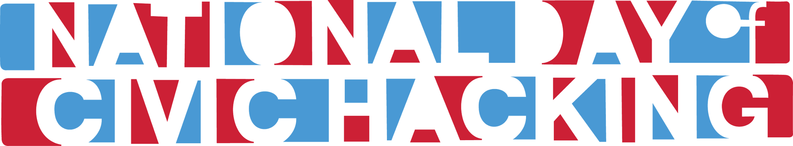
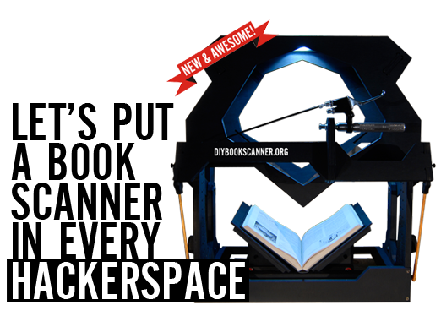
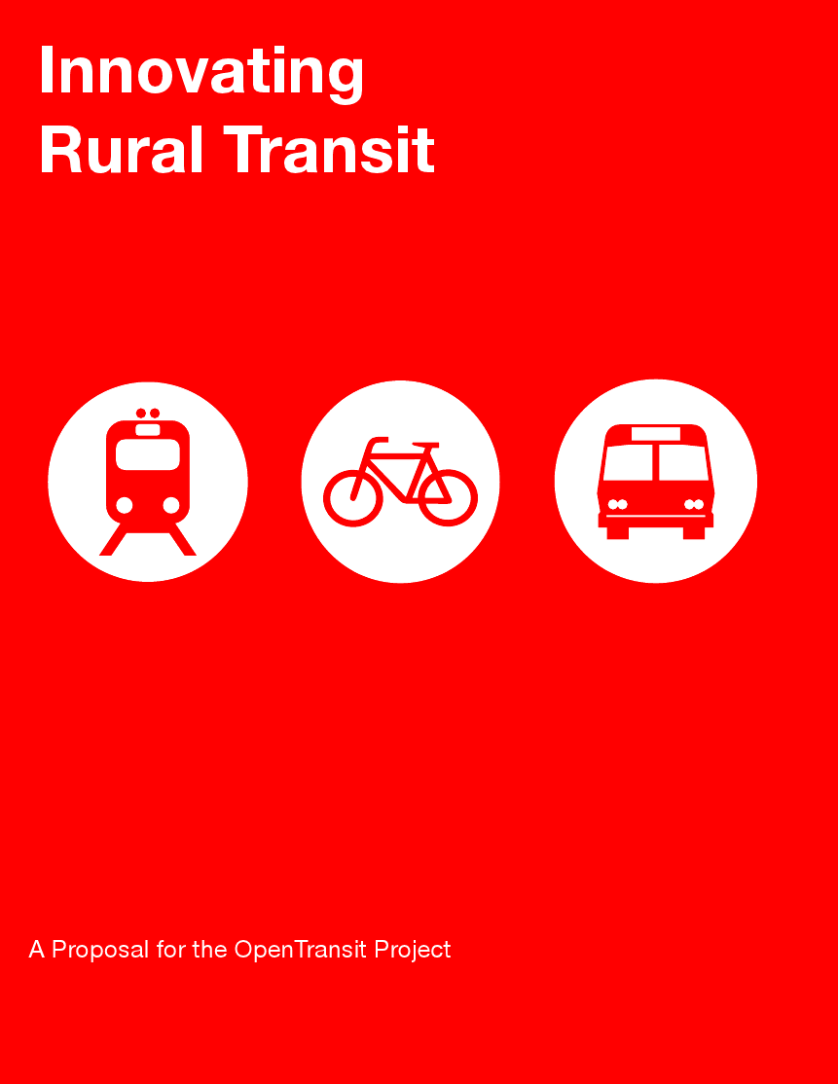
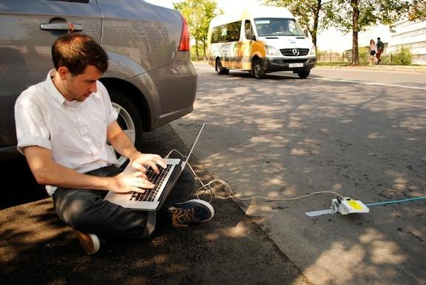
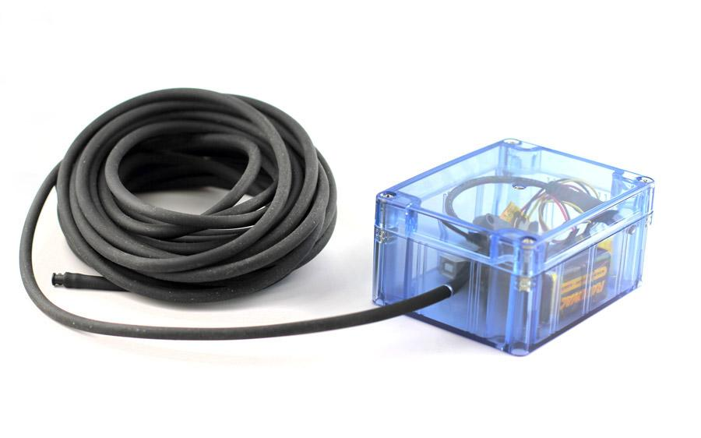

Slide 11

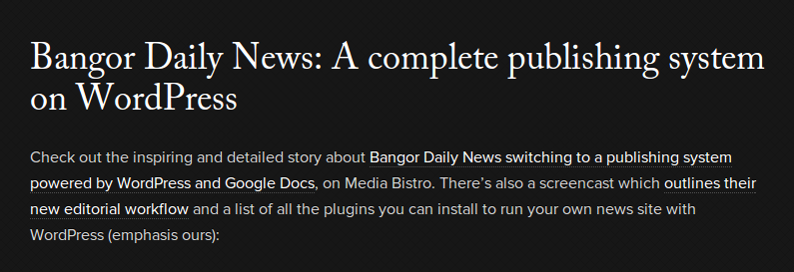

Open Source Collaboration in Maine
The Bath Freight Shed Alliance combined a traditional fundraising campaign with community groups like the Rotary Club with an online crowdfunding platform called Kickstarter to raise over $18,448 for a new community event space.
The Bangor Daily News uses an open source web-publishing platform called Wordpress, along with a cloud-based productivity suite called GoogleDocs to write, edit and publish articles in real-time.
Both are examples of how traditional, small institutions can use cloud computing, crowdsourcing, and open source applications to accomplish things which never would have been possible in the past.

Slide 12

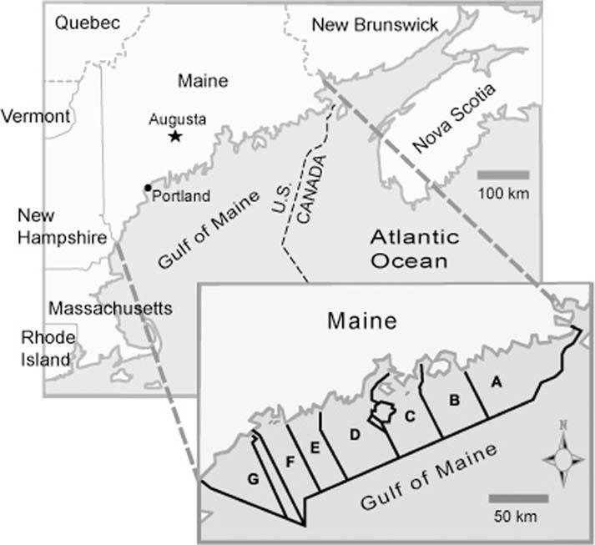

Slide 13
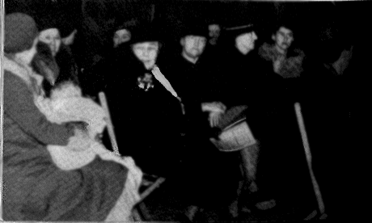
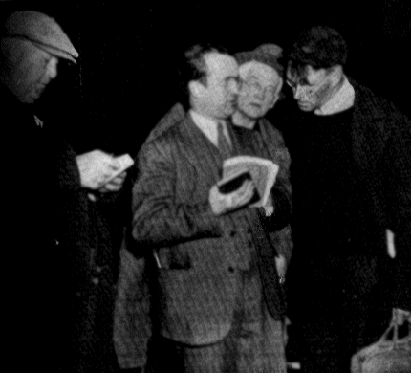
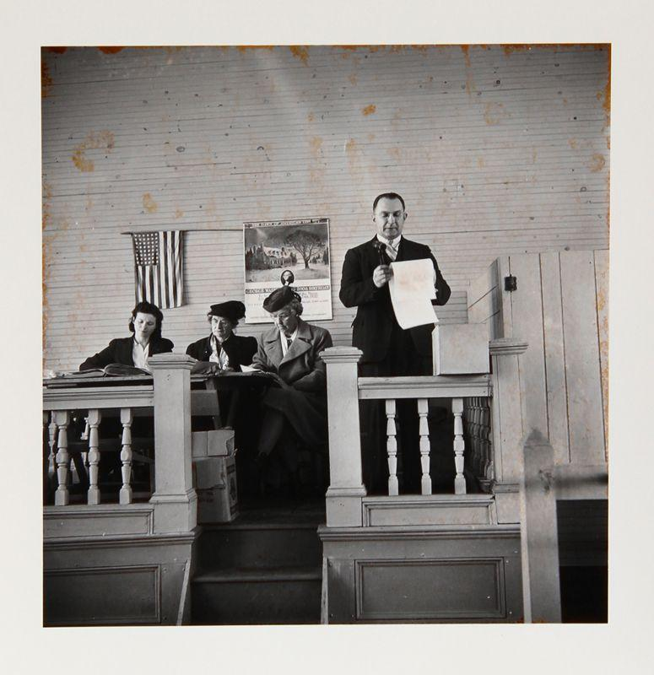
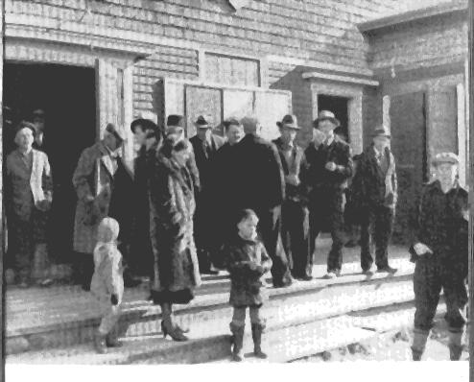

Slide 14
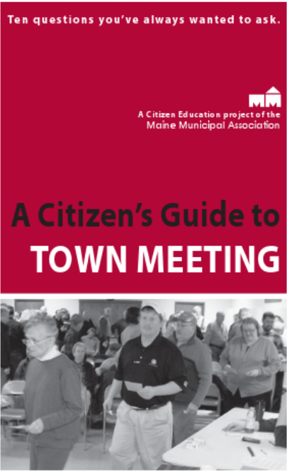
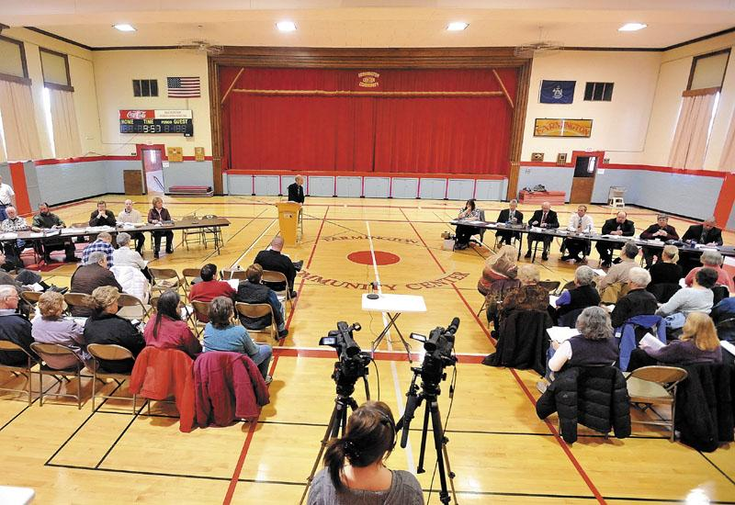
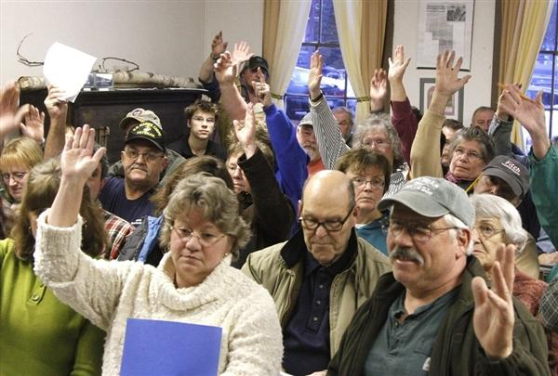

Slide 15






Online Participation Tools Can Enhance Traditional Public Dialogue
Traditional Public Outreach Meeting
Online Participation Tools
Discussion continues online where next meeting date will be set
Meeting uses video webcast. Citizens, guest speakers and absent committee members are given various options to submit questions
Directions for Joining Online Community Announced at Meeting

Slide 16
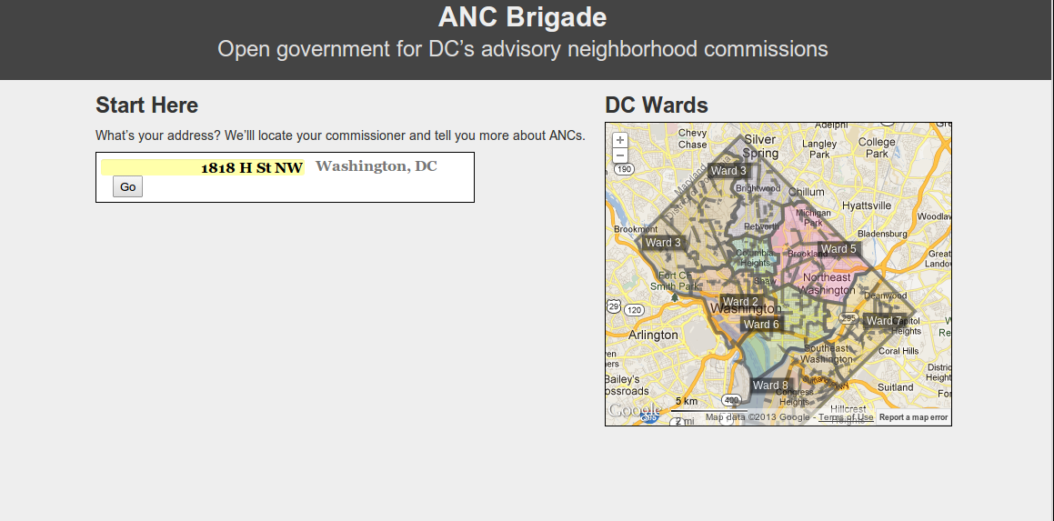
Strengthening Hyper-Local Government
ANCBrigade is a project in Washington, D.C. to strengthen our unique hyper-local level of government called Advisory Neighborhood Commissions (ANCs).
The District is divided into 40 ANCs, about 5 per ward. Each ANC is made up of about 7-8 commissioners. Commissioners are each elected from Single Member Districts (SMDs) comprising about 2,000 District residents. There are 296 ANC commissioners (and SMDs) in the District.
This website is a project of the DC chapter of the Code for America Brigade. We’re volunteers interested in using technology to solve problems in our civic lives. This is a work in progress.

Slide 17
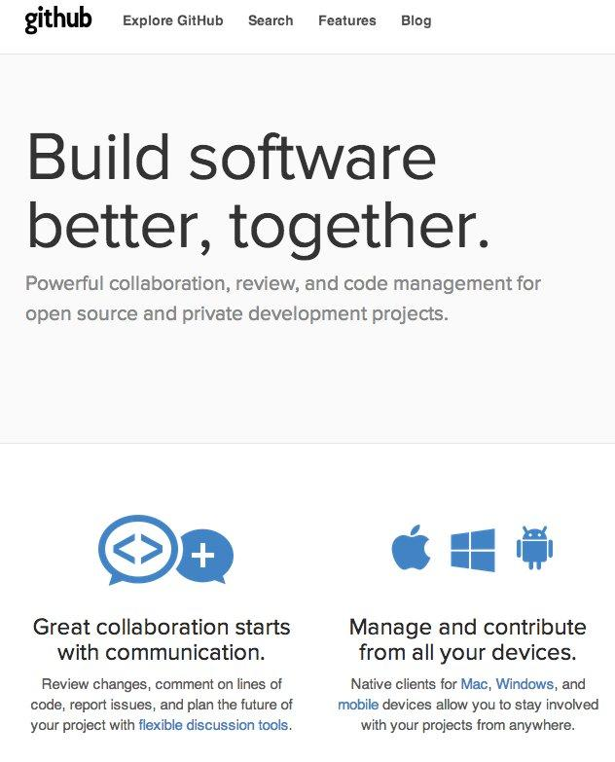
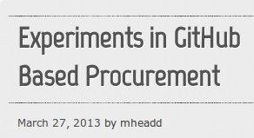
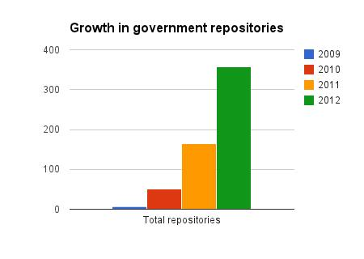

Slide 18
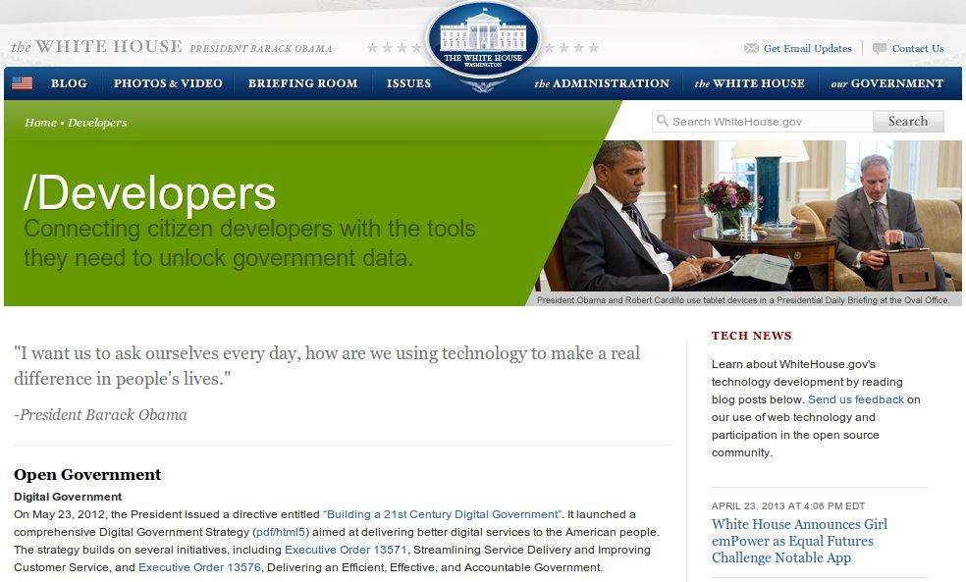
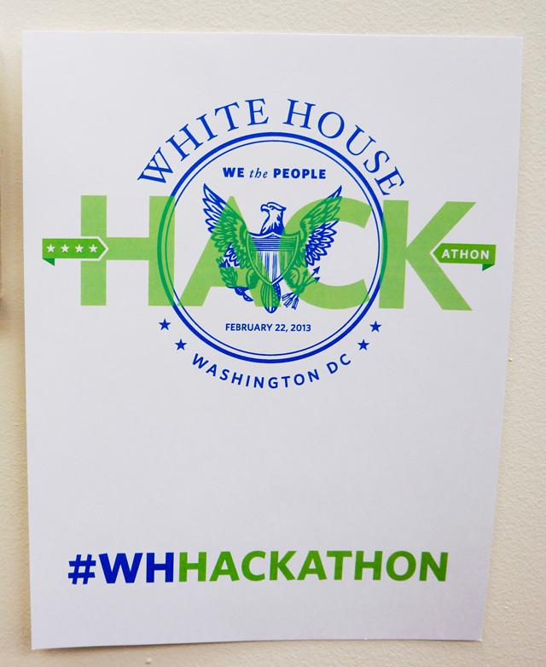

Slide 19
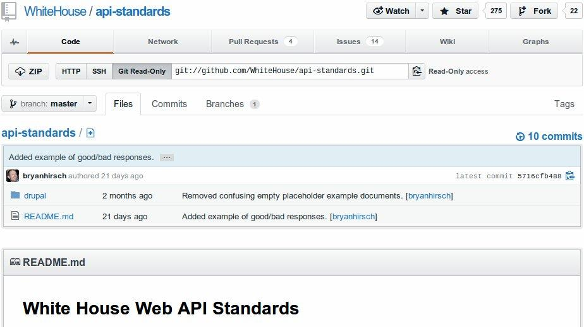

Slide 20
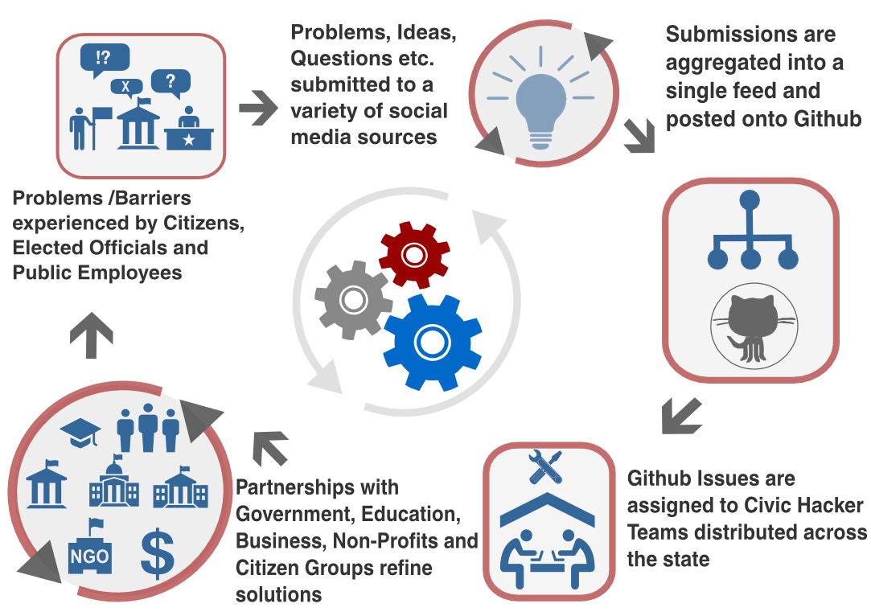

Slide 21
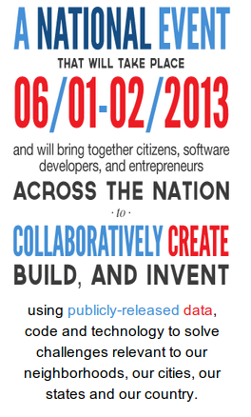
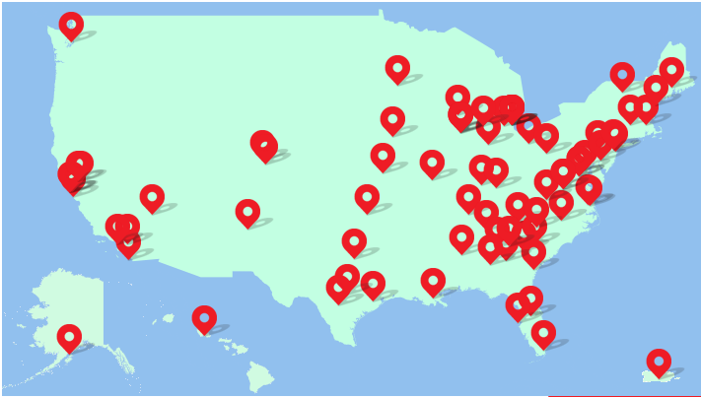
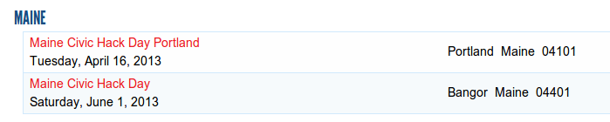

Slide 22
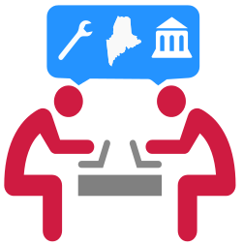





Join Us
https://www.facebook.com/code4maine
http://www.meetup.com/Code-for-Maine/
Code4ME Google+
maine-brigade.google.groups
www.github.com/code4maine

